Slide 1
Introduction to Computing for Data Analysis
Case study: PageRank (Markov chains on graphs)
Richard Vuduc, Ph.D.
Associate Professor
School of Computational Science and Engineering
A linear algebraic view
Notes:
In this lesson, let’s revisit the random surfer model, but this time from the perspective of linear algebra.
Why? Well, if you can formulate a calculation in terms of linear algebra, then that will lead to compact and efficient ways to implement it.

Slide 2
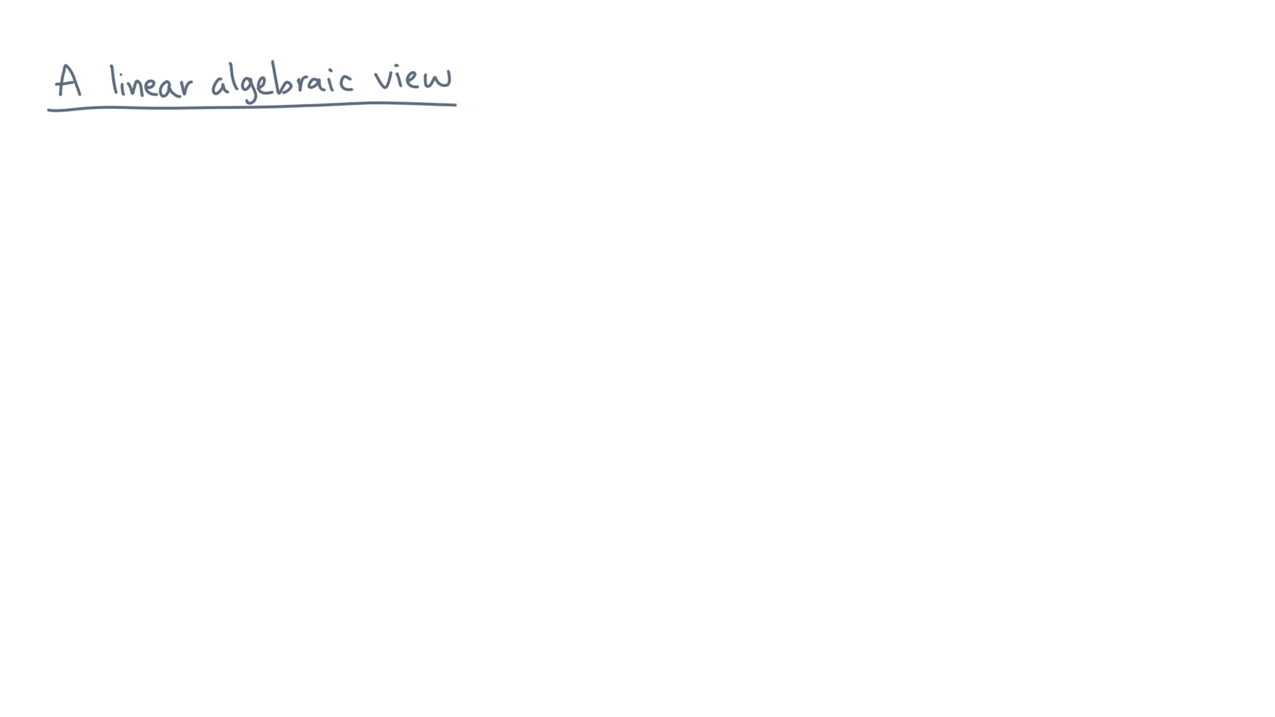
Notes:
Recall the problem of a random surfer traversing a graph.

Slide 3
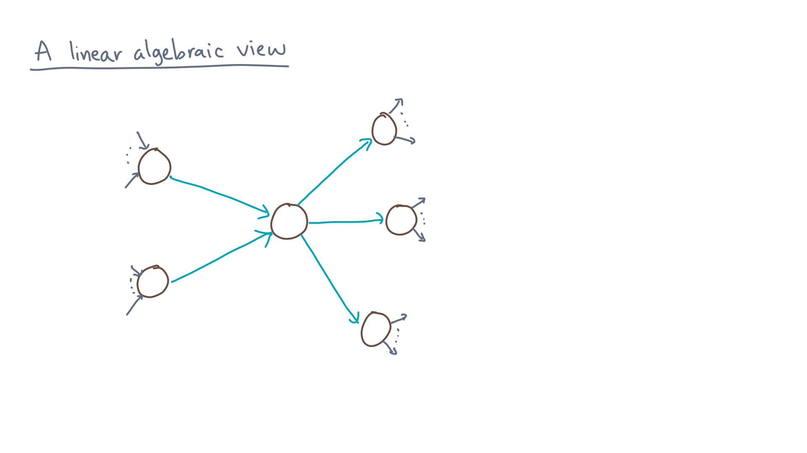
Notes:
The chance that he or she is on a given node “eye” is given by this summation.

Slide 4
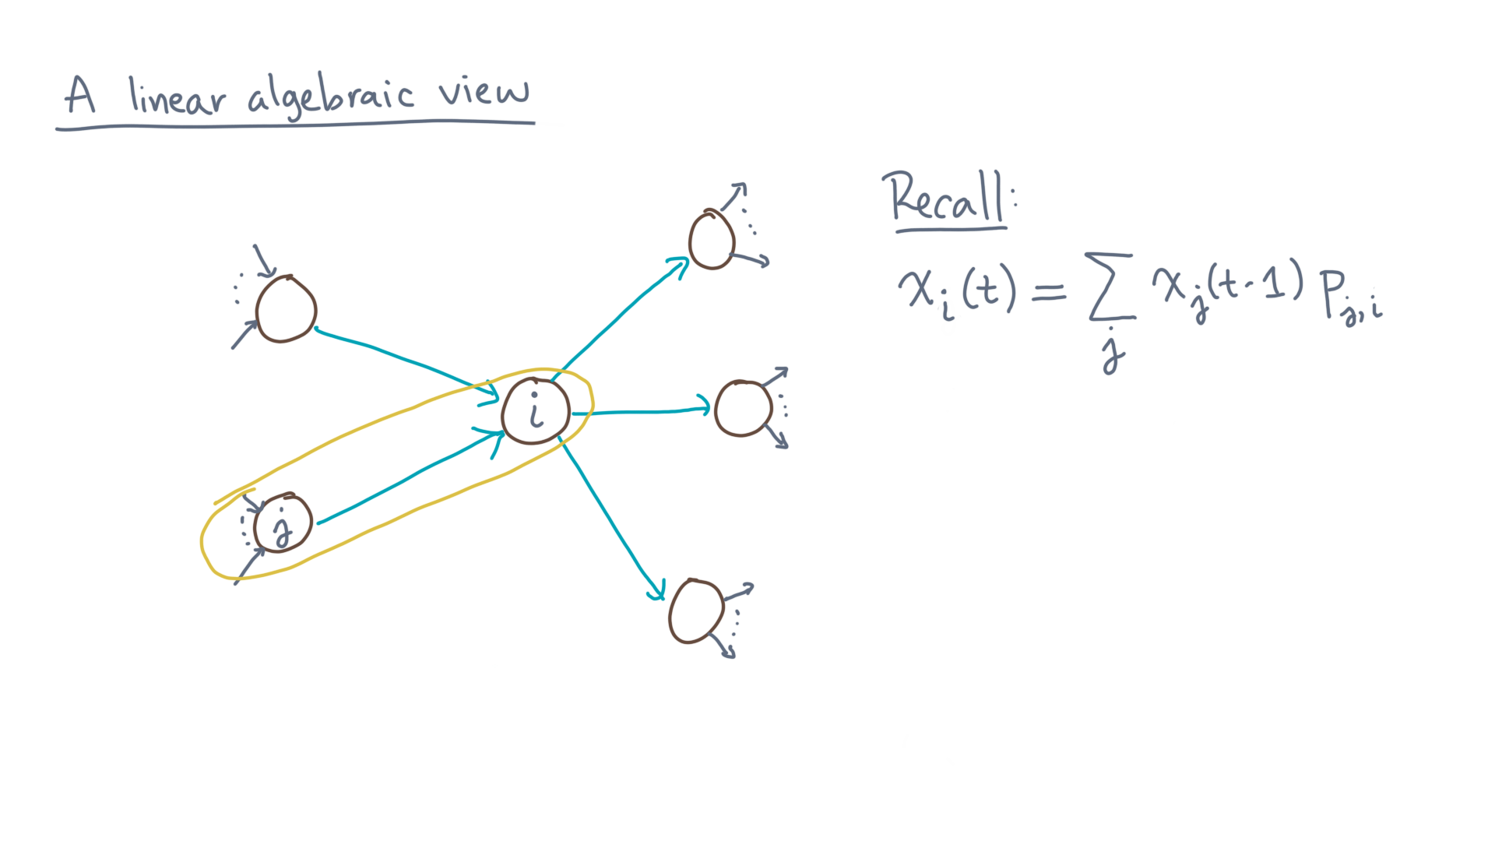
Notes:
For all nodes “jay” that go to “eye,” the product of “x-jay-of-tee-minus-one” and “pee-sub-jay-eye.”

Slide 5
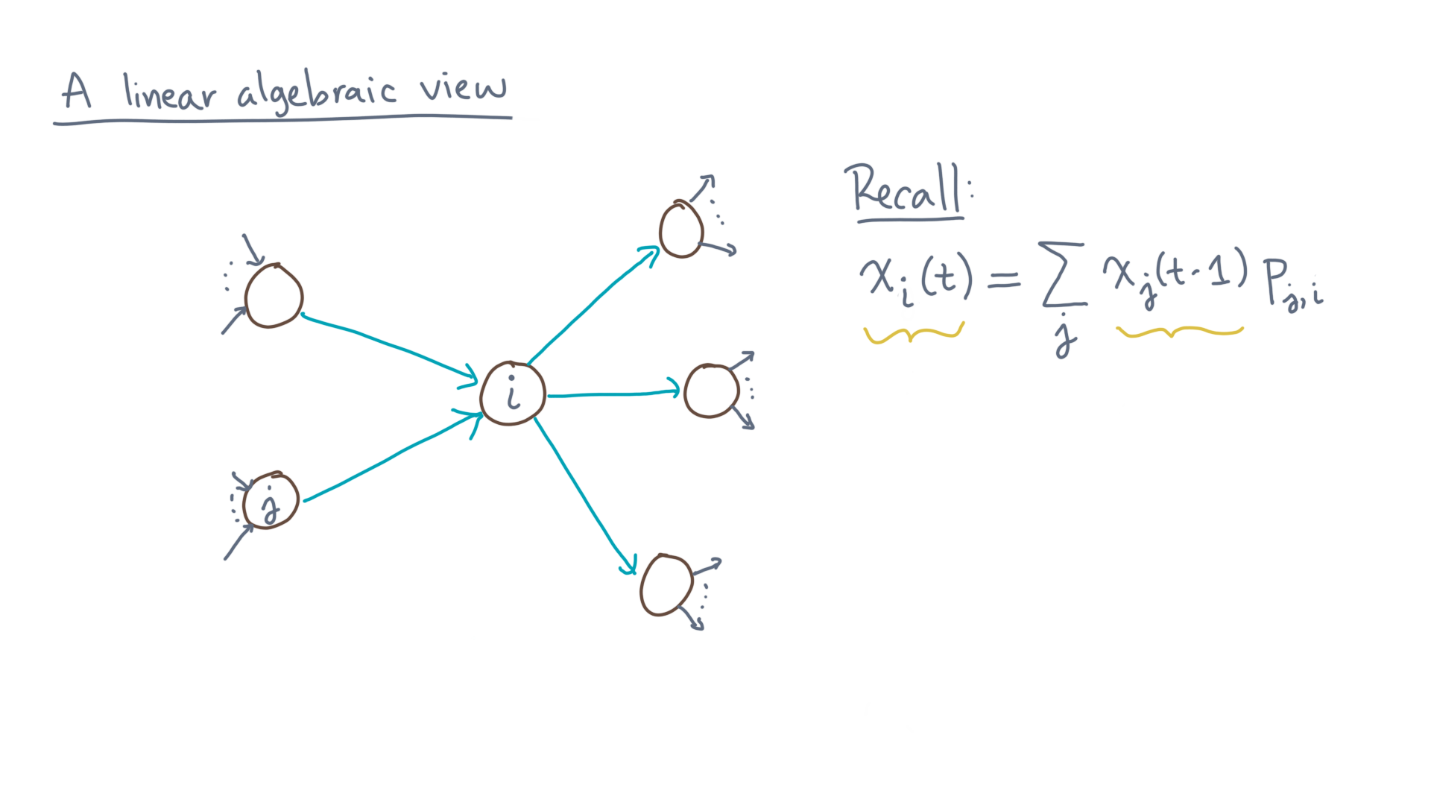
Notes:
Let’s consider the x-eye-of-tee and x-jay-of-tee-minus-one variables.

Slide 6
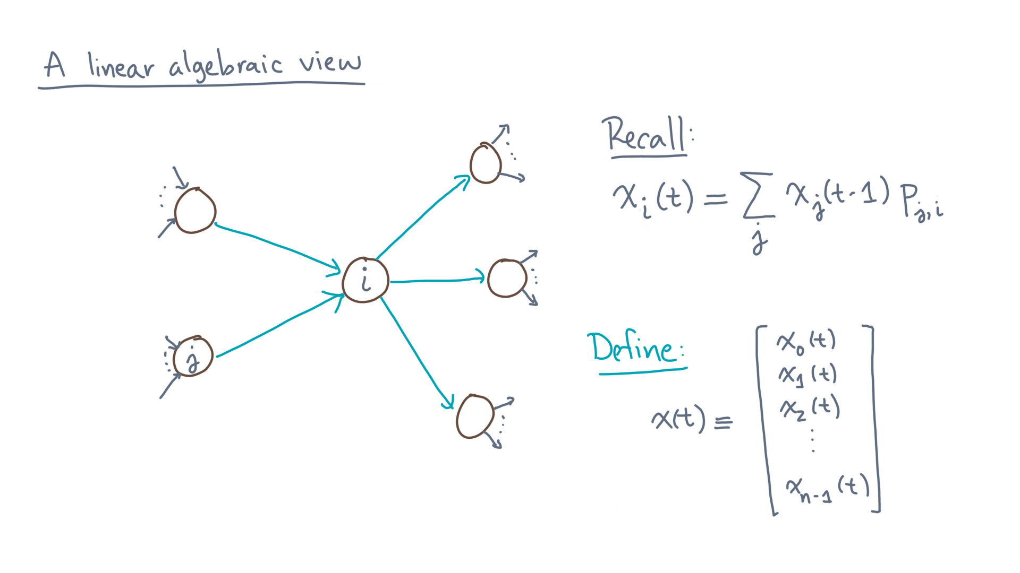
Notes:
Define a column vector, x-of-tee, whose entries are all the individual x-eye-of-tee variables.

Slide 7
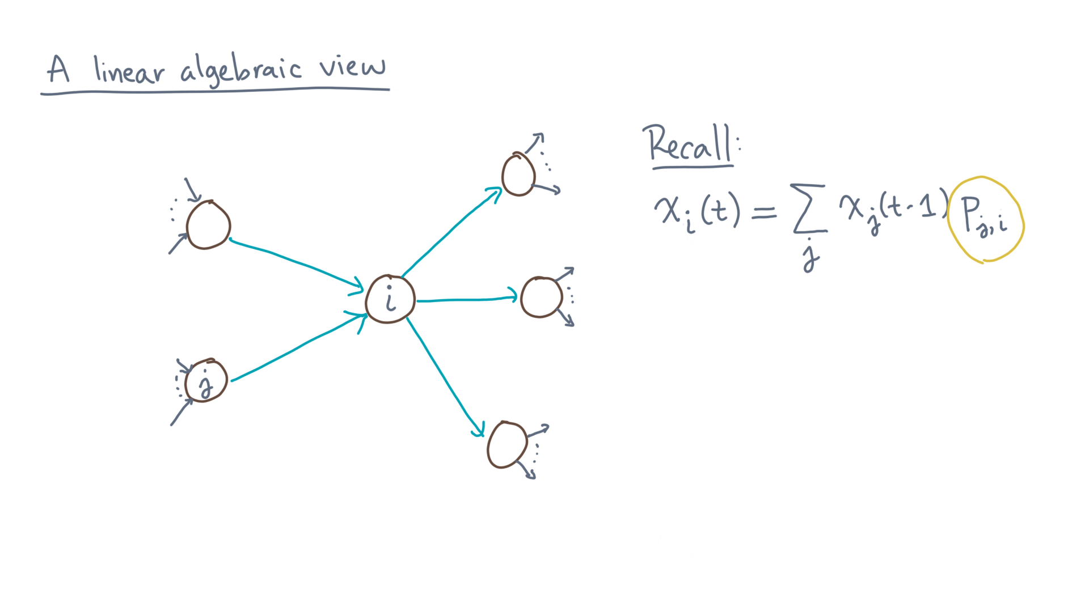
Notes:
Next, consider the transition probabilities, “pee-jay-eye.”

Slide 8
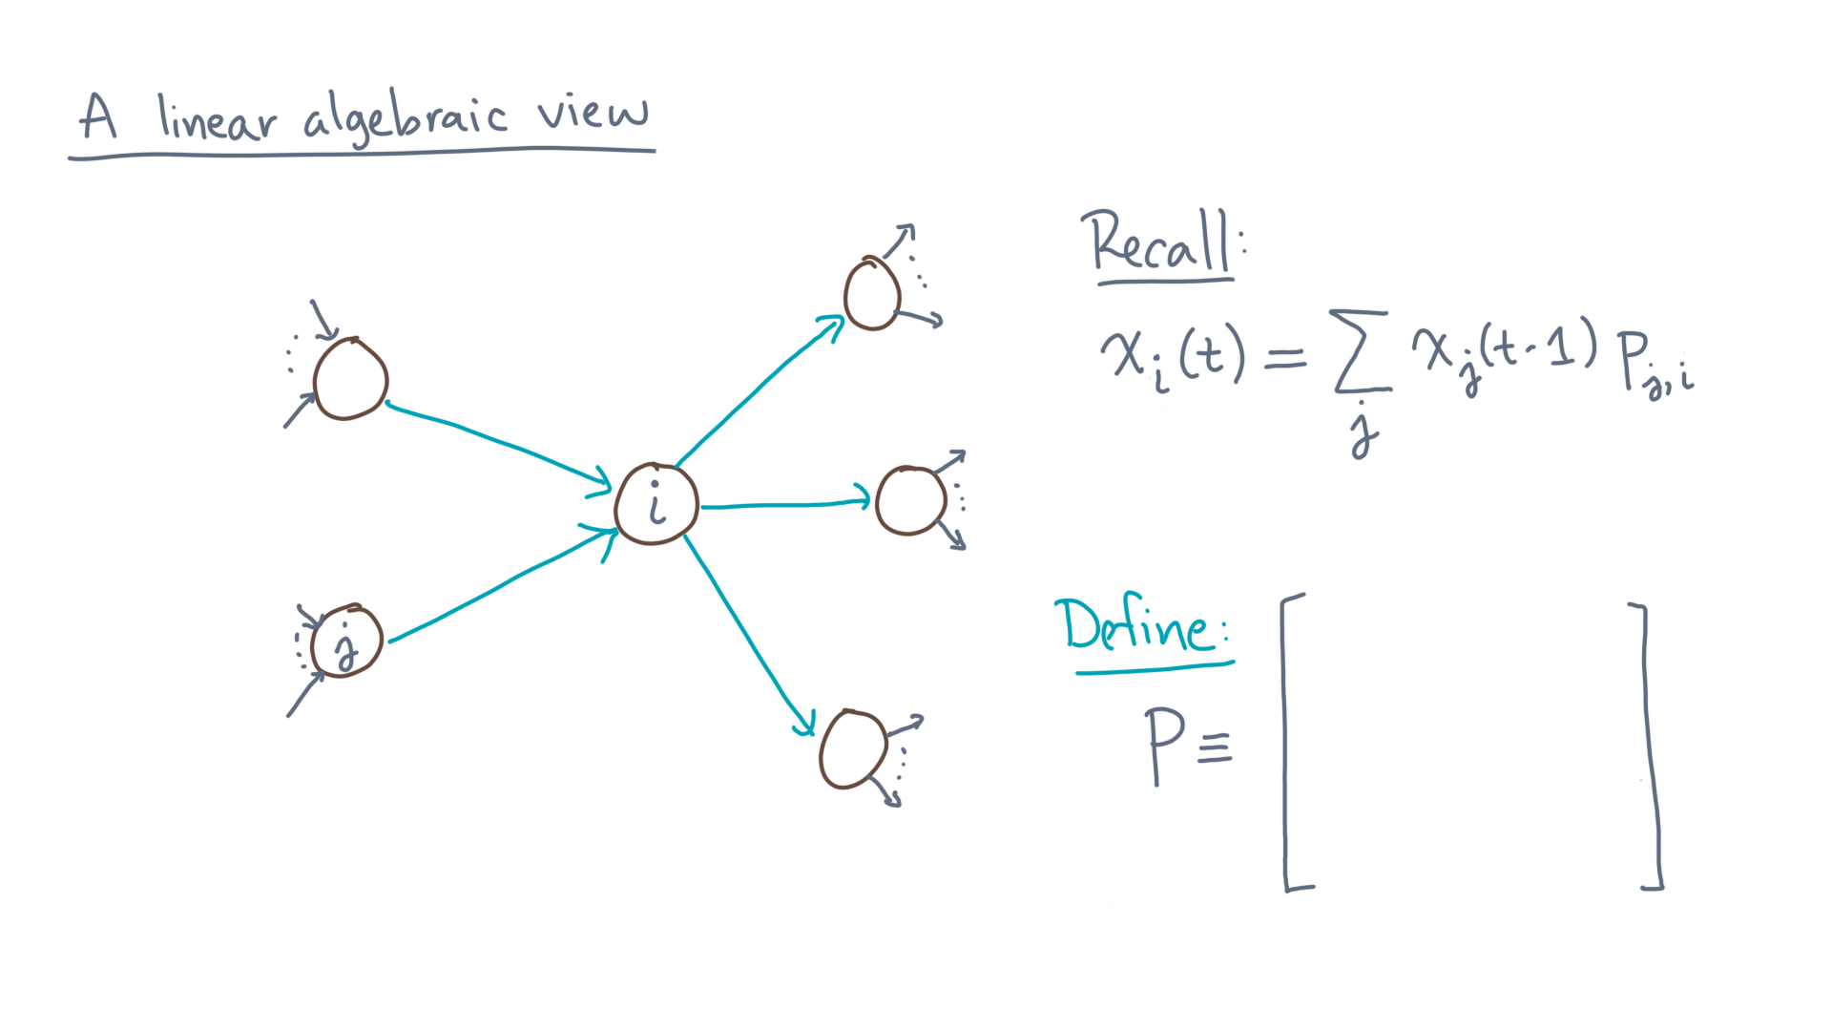
Notes:
Let’s represent these in a matrix, “capital-pee.”

Slide 9
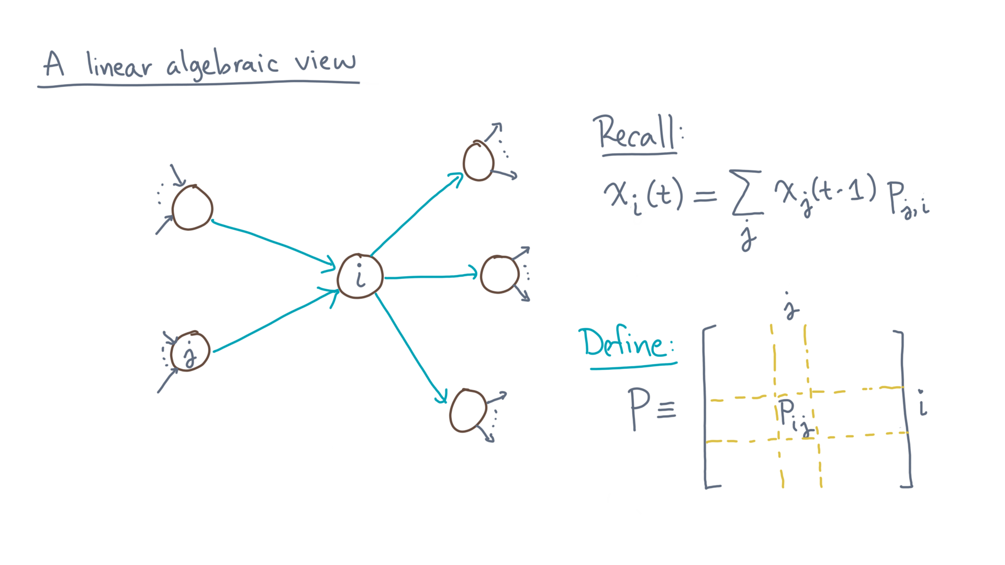
Notes:
Let’s use the convention that element “pee-eye-jay” resides in row “eye” and column “jay” of this matrix.

Slide 10
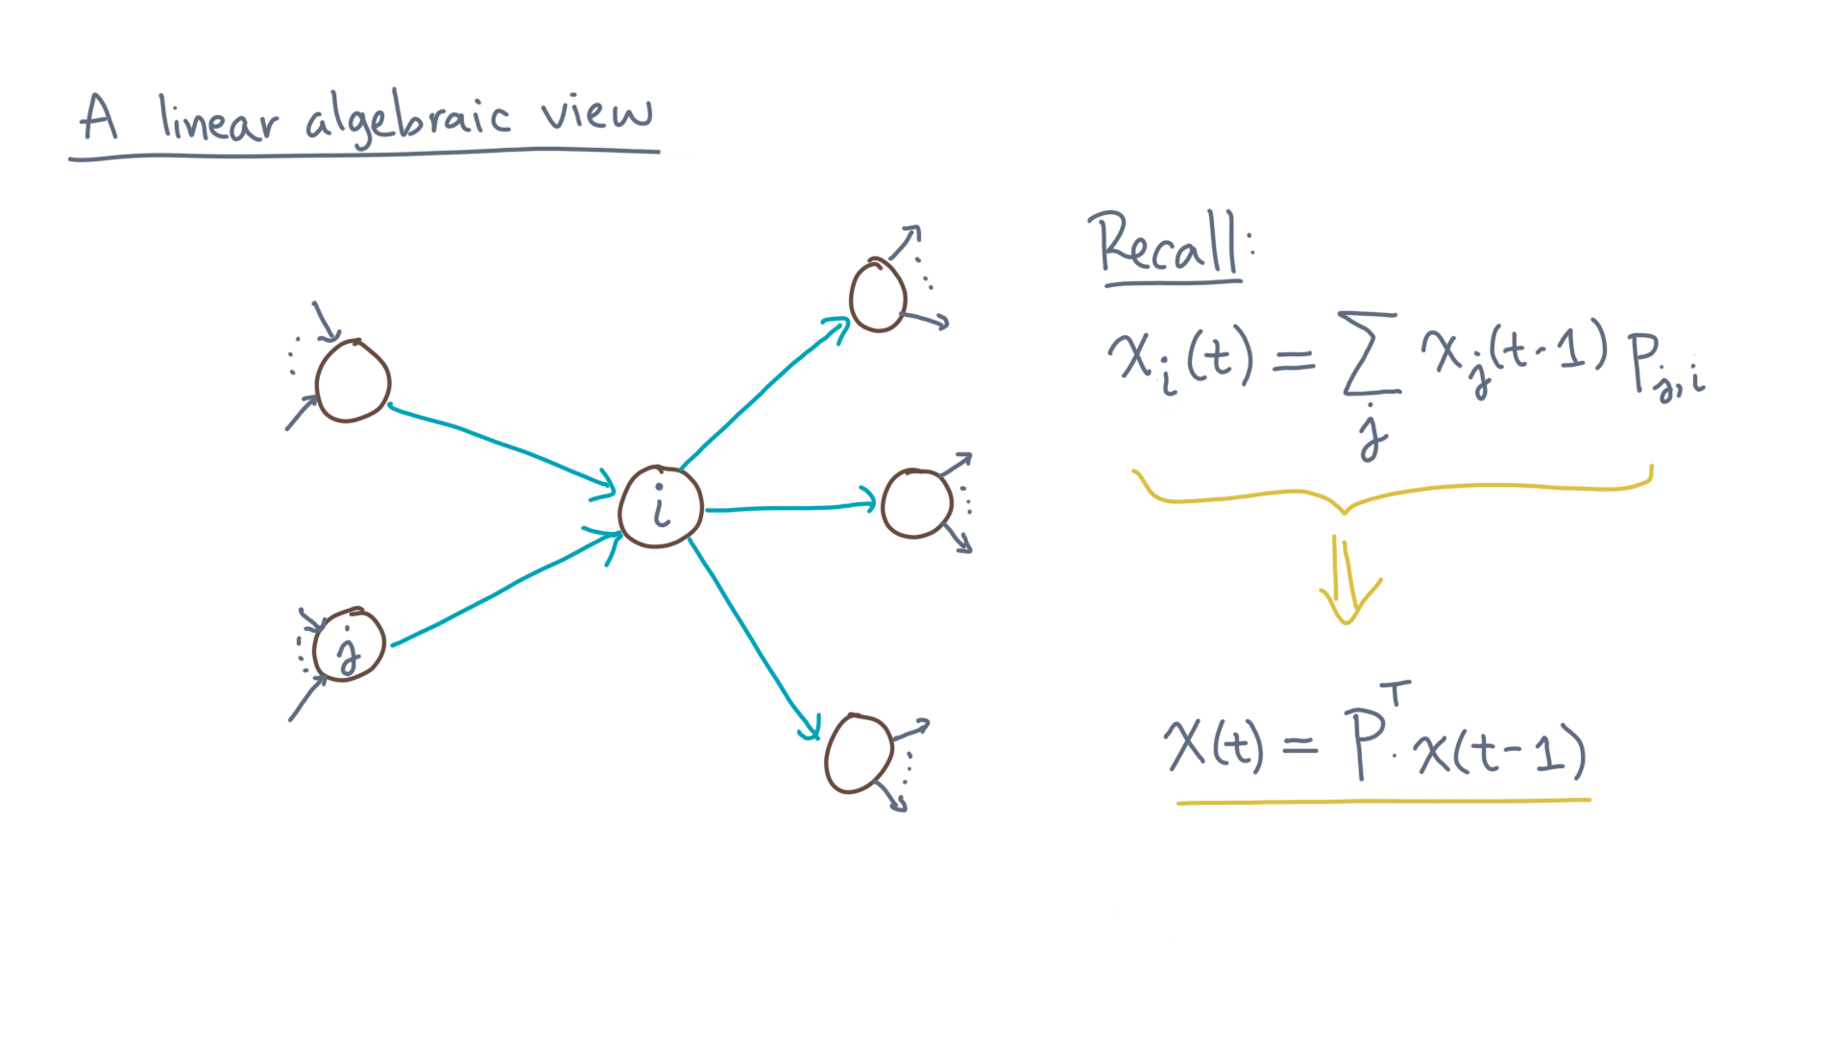
Notes:
From this notation, you can write down a simple matrix model of the surfer’s behavior:
X-of-tee equals P-transpose times x-of-tee-minus-one.

Slide 11
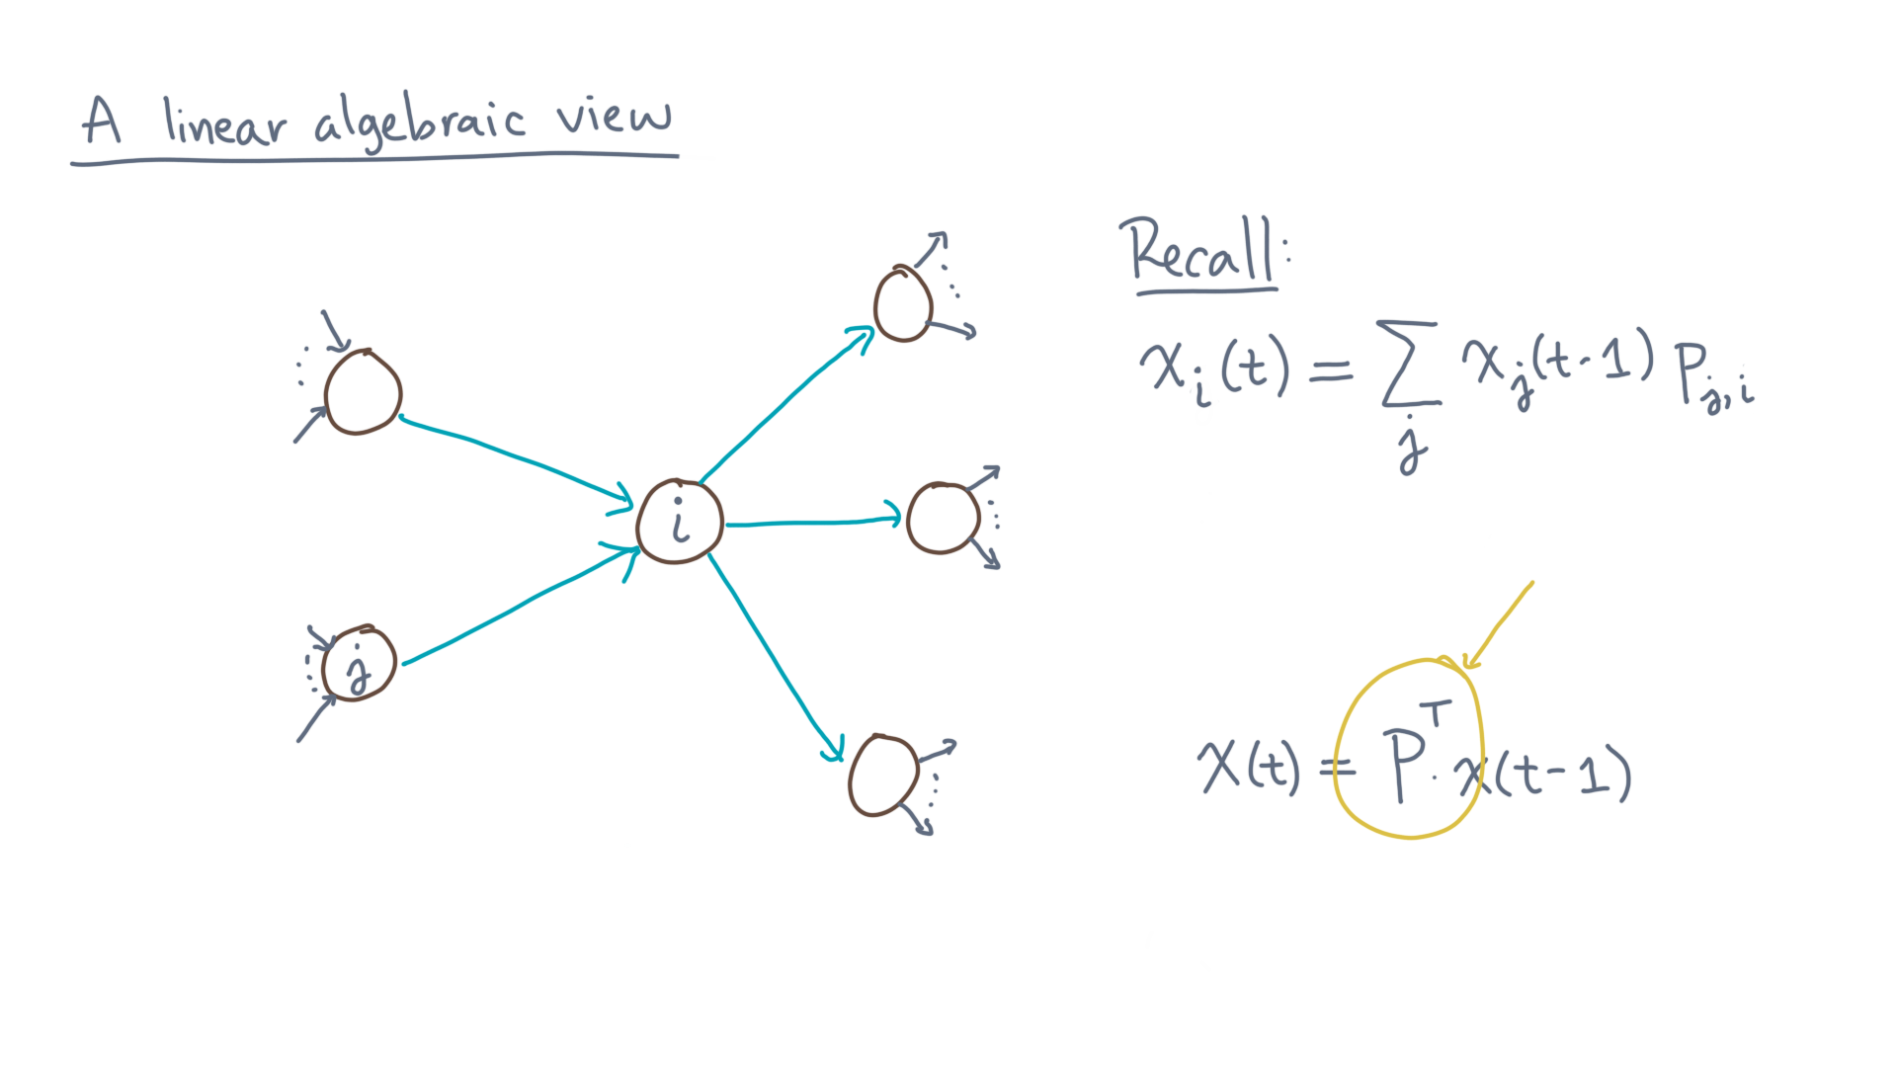
Notes:
Take special note of the “transpose.”
Its presence is a consequence of two conventions: that “x-of-tee” is a column, rather than row, vector, and that “pee-eye-jay” is row “eye” and column “jay” of “pee.”

Slide 12
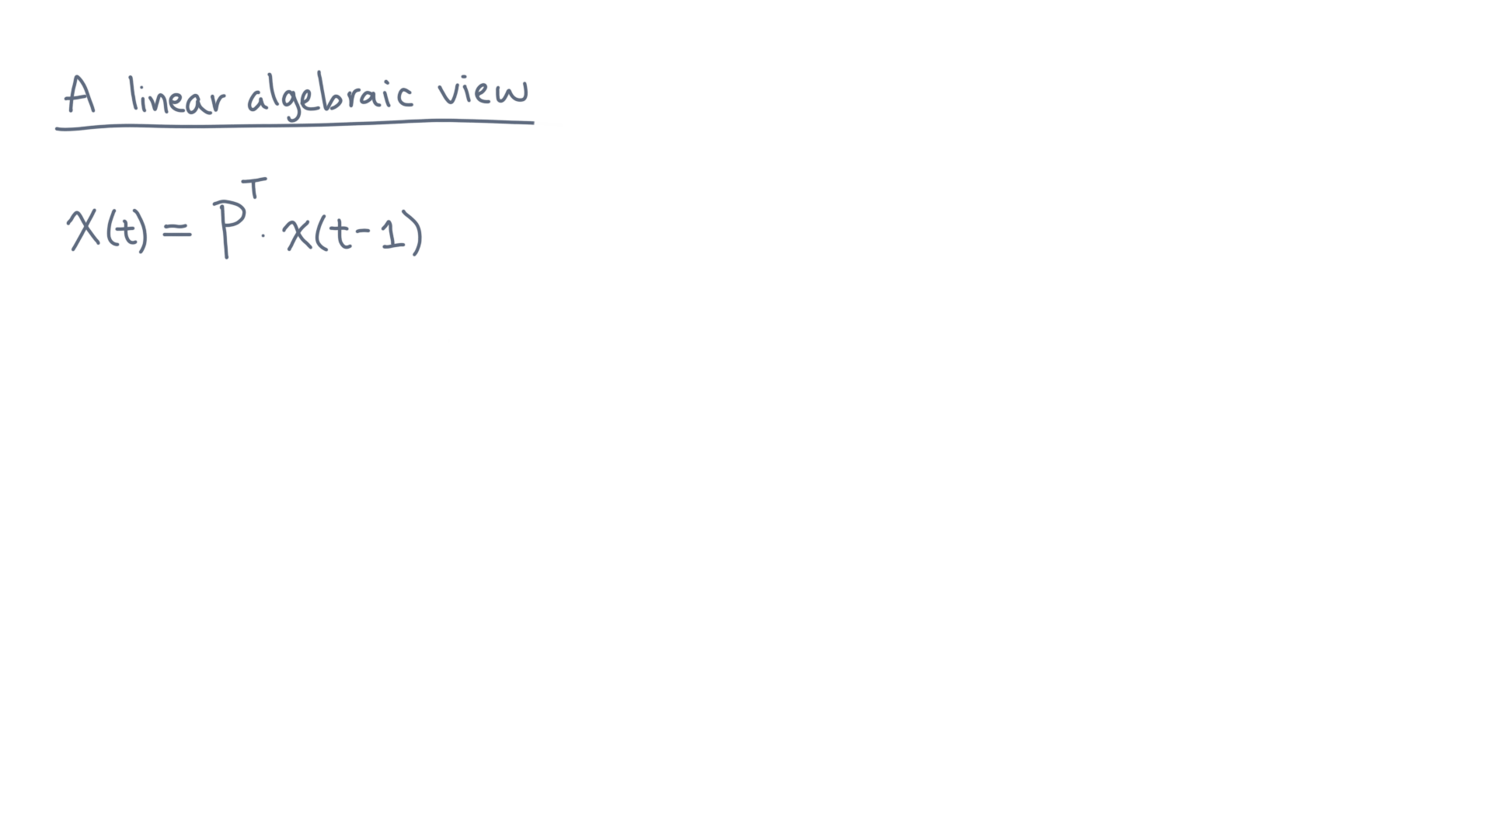
Notes:
The matrix equation helps us in a few ways.

Slide 13
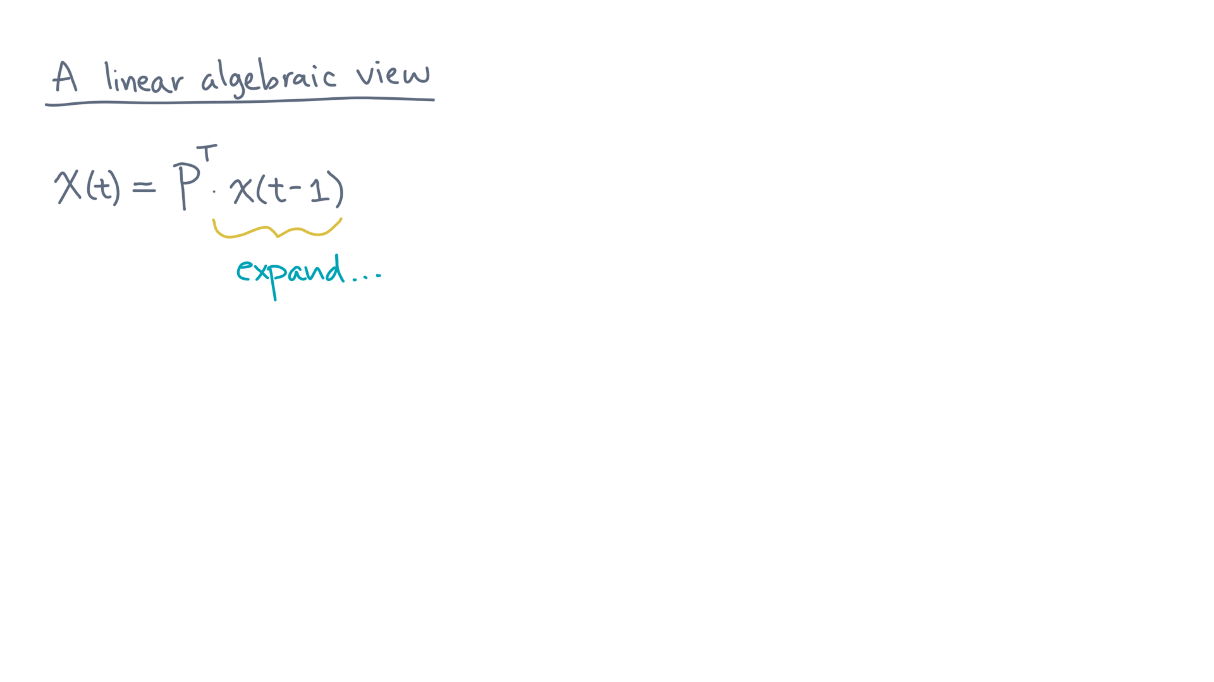
Notes:
First, suppose you expand x-of-tee-minus-one.

Slide 14
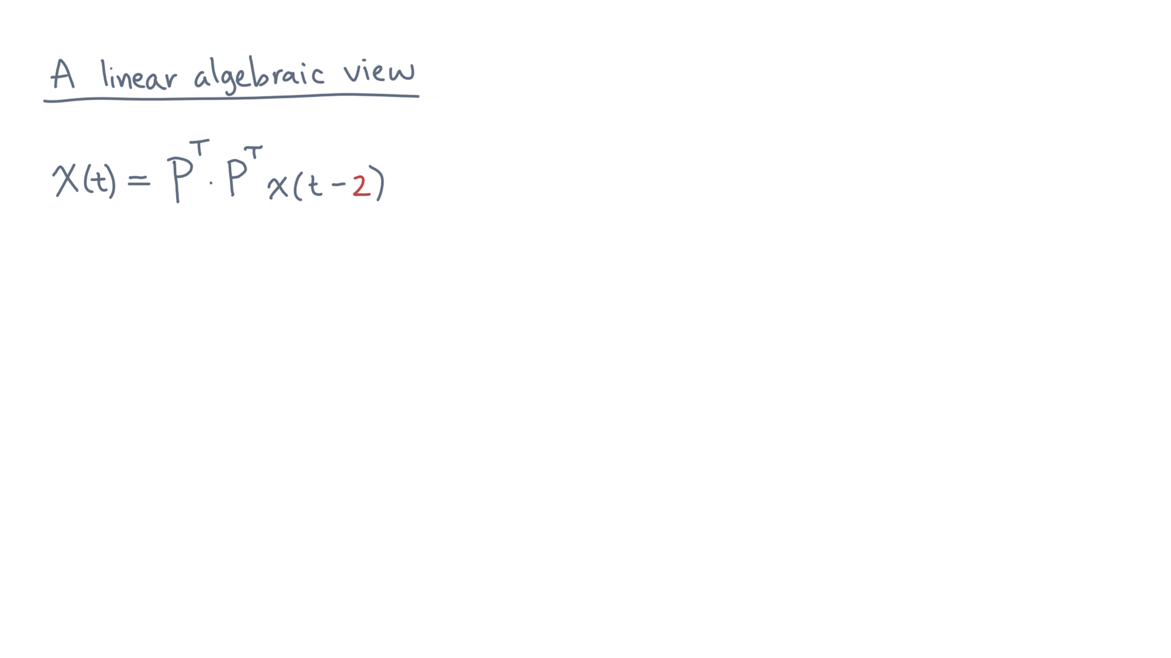
Notes:
You get P-transpose times P-transpose times x-of-tee-minus-two.

Slide 15
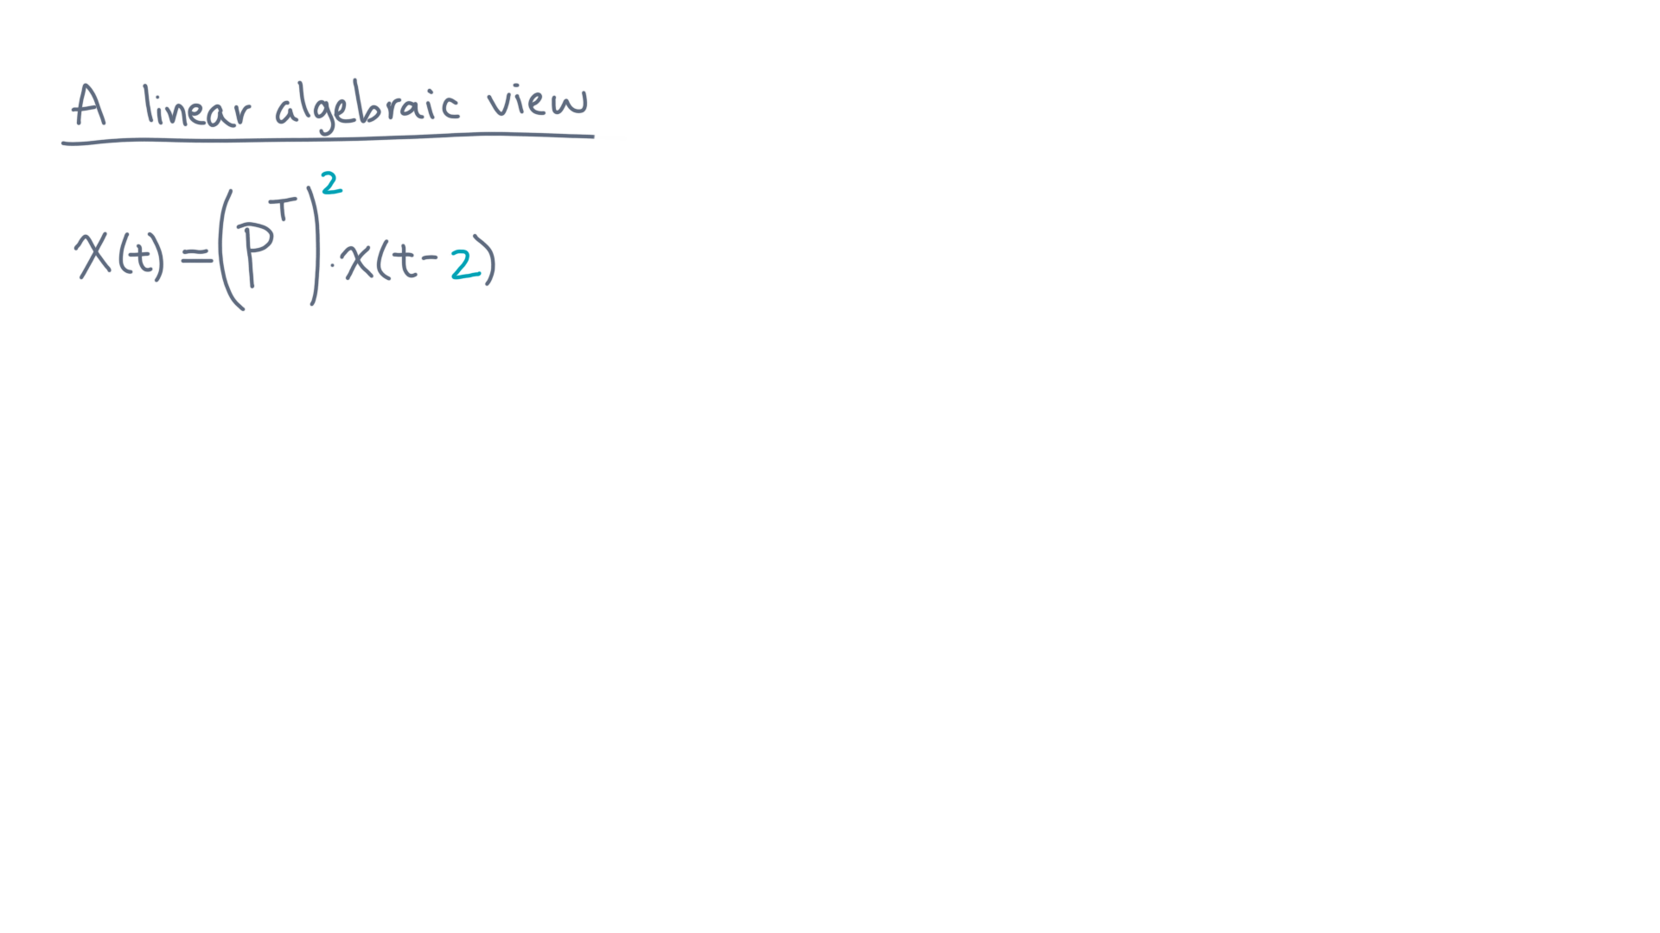
Notes:
In other words, P-transpose-squared times x-of-tee-minus-two.

Slide 16
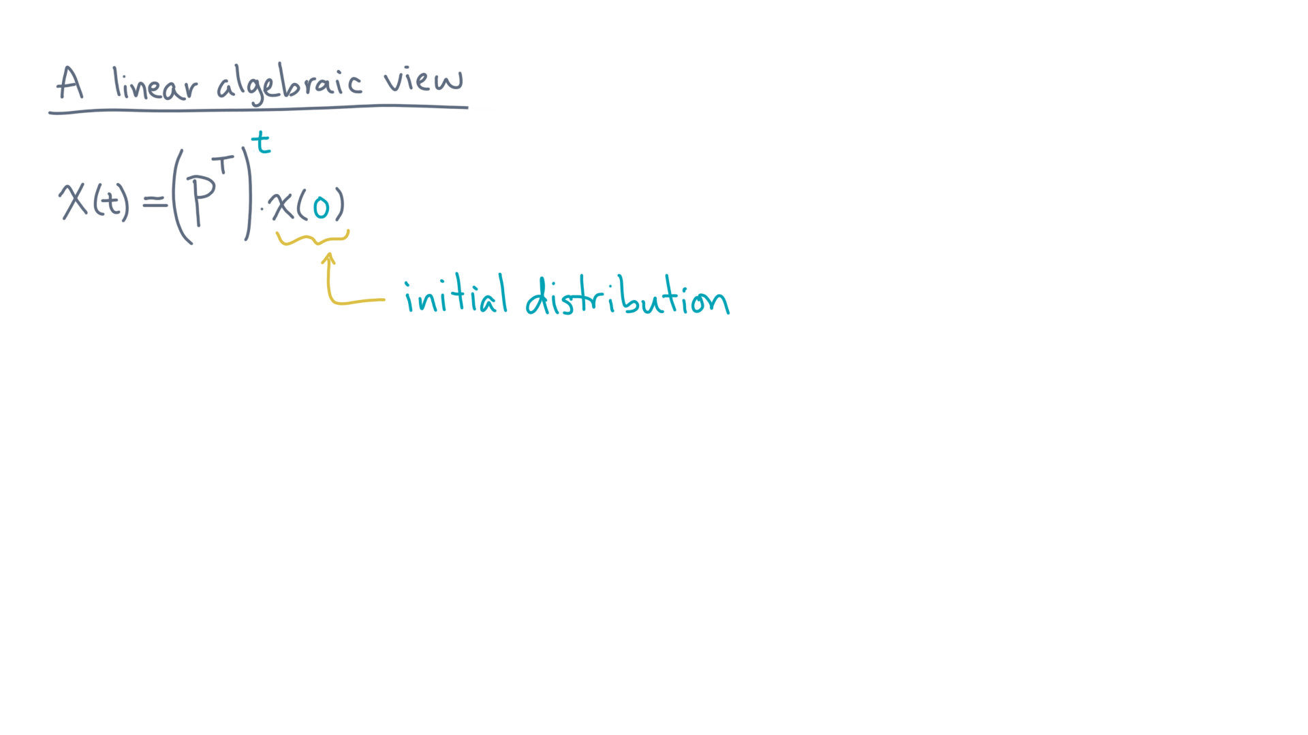
Notes:
Continuing, you would get P-transpose-to-the-power-tee times x-of-zero, which is the initial distribution.

Slide 17
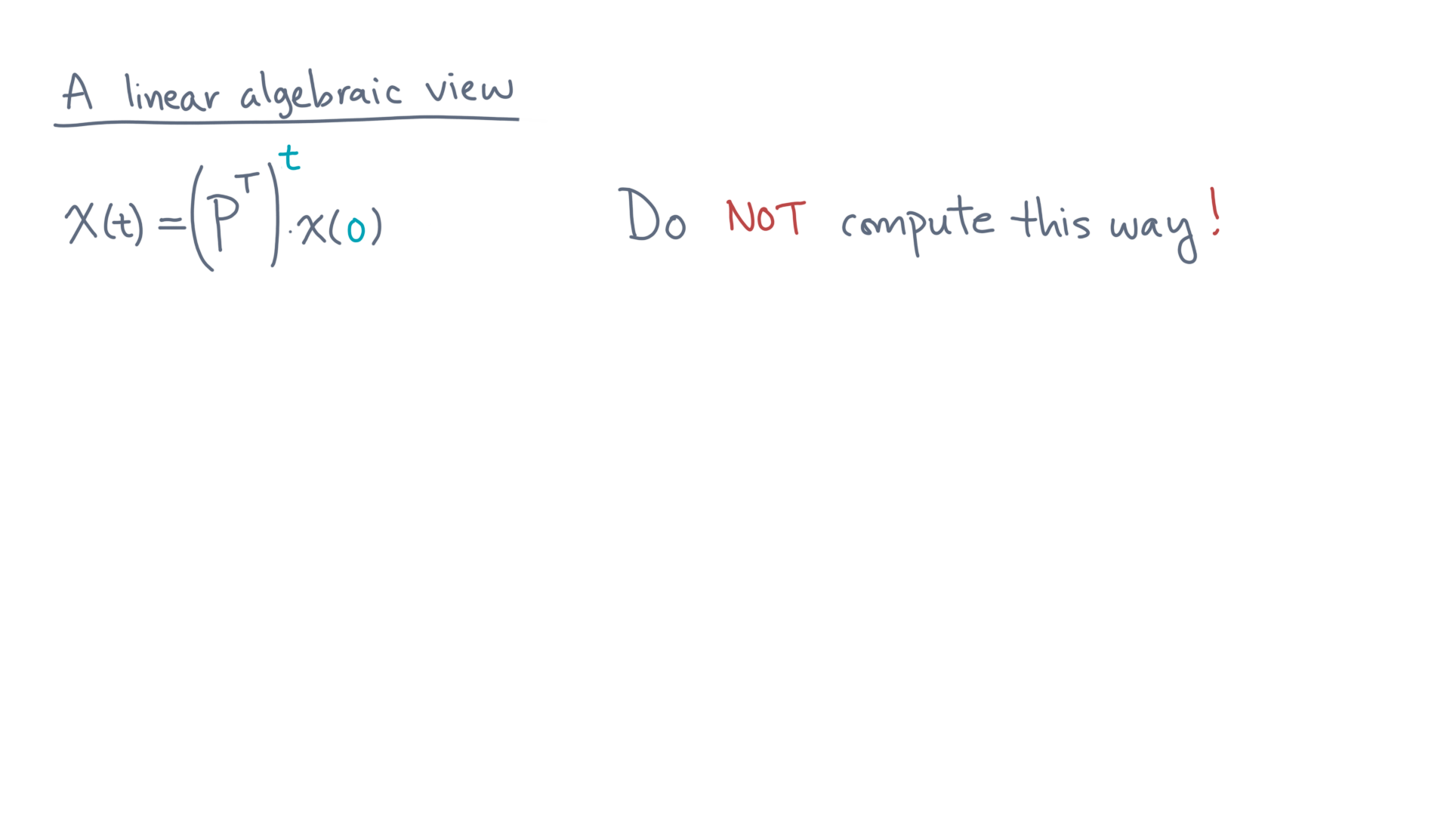
Notes:
One important note: this form of raising the matrix to a power is helpful mathematically, but you should *not* calculate it this way.

Slide 18
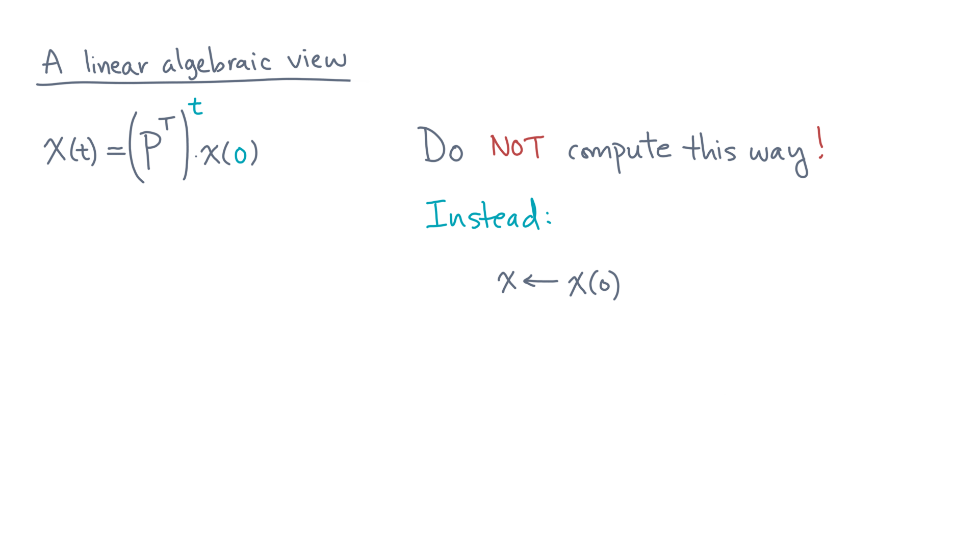
Notes:
Instead, you should start with the initial distribution.

Slide 19
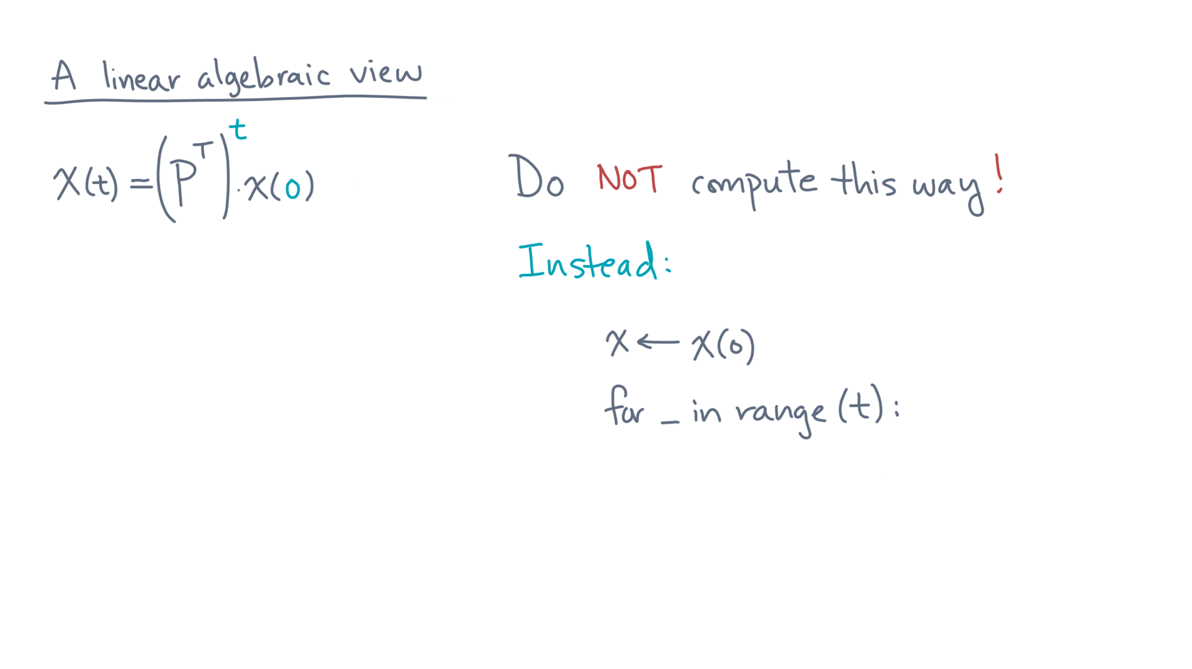
Notes:
Then, in a loop, do the following.

Slide 20
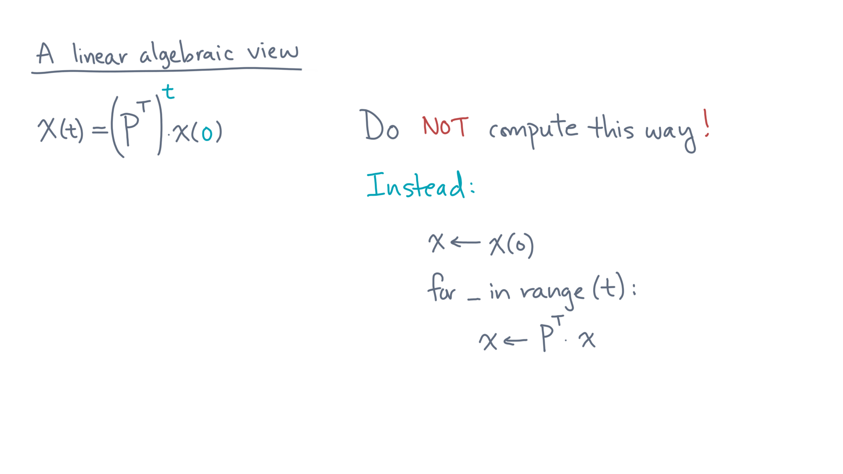
Notes:
Multiply the current distribution by P-transpose, and then repeat until done.
You should pause for a moment and think about why this approach is better than first raising P-transpose to the power tee.

Slide 21
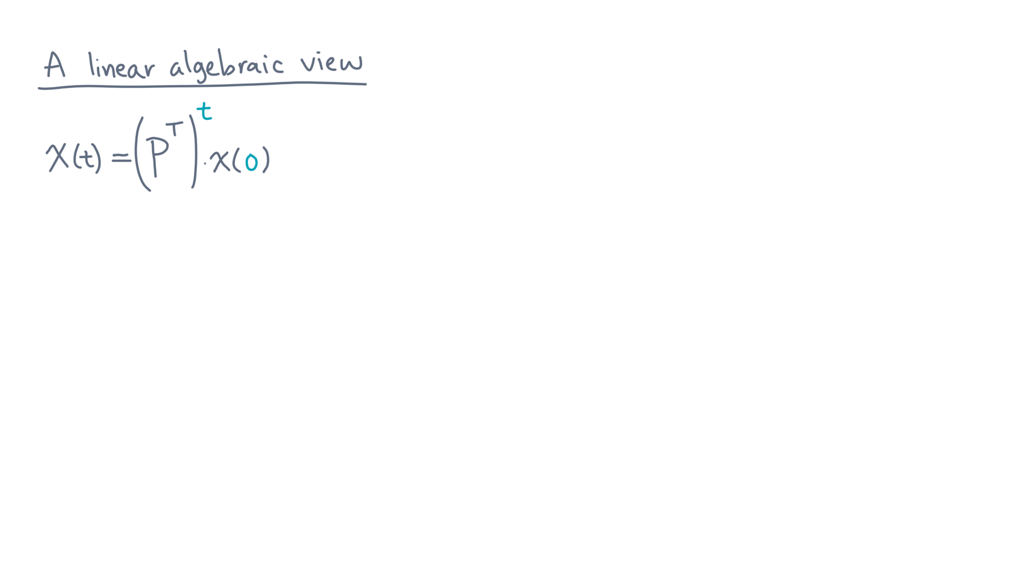
Notes:
Linear algebra also allows for mathematical analysis of this process.
For instance, consider the following question.

Slide 22
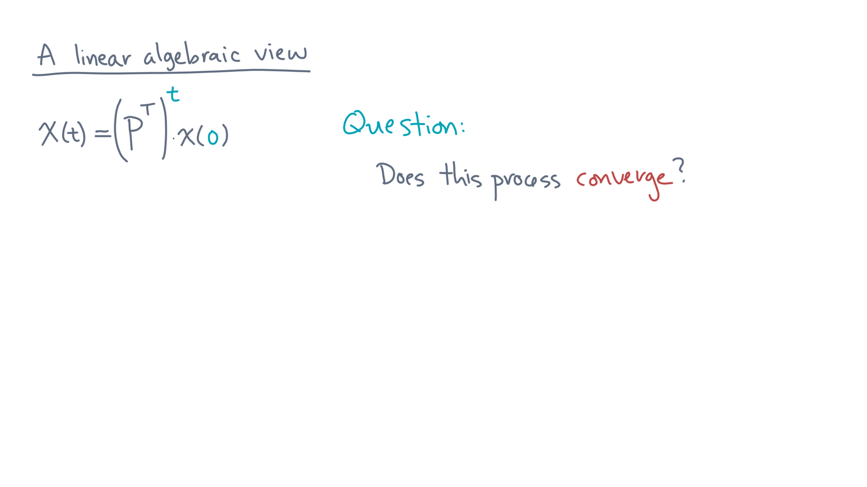
Notes:
Does this process converge?

Slide 23
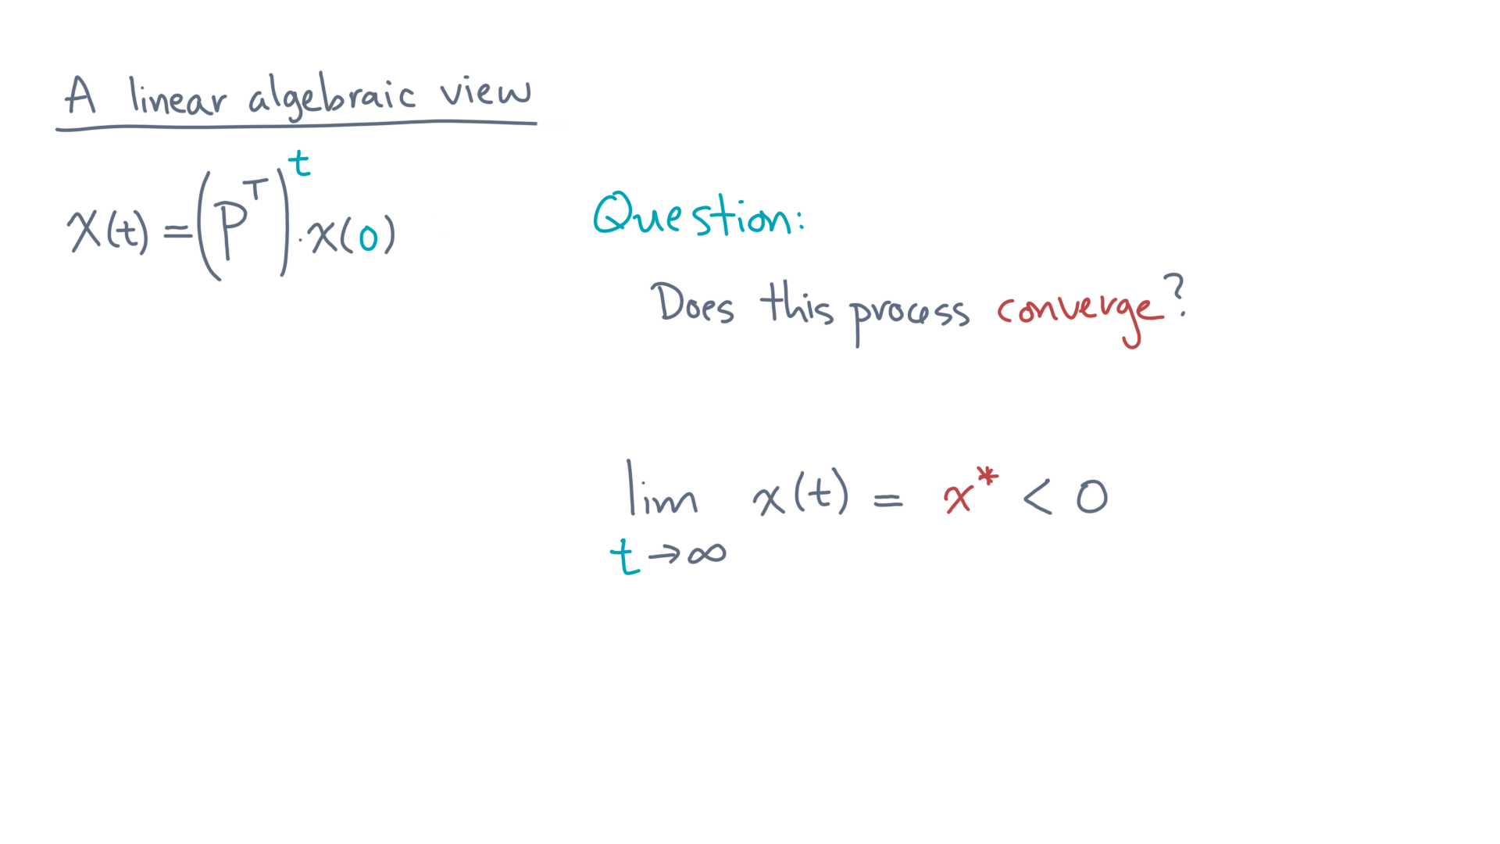
*
Notes:
That is, in the limit that tee goes to infinity, is there a finite limiting distribution?

Slide 24
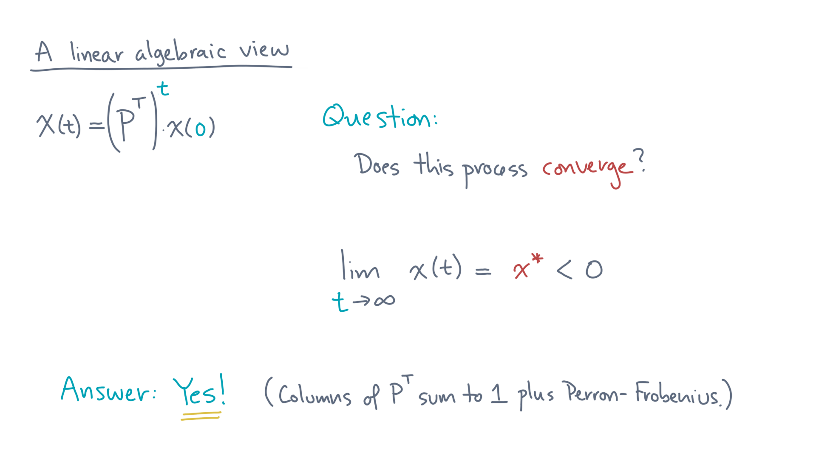
*
Notes:
The answer is a resounding “yes.” And that stationary distribution is unique.
The reason is technical, but stems from two facts: first, that the columns of P-transpose sum to one and secondly, from a result known as the Perron-Frobenius theorem.

Slide 25
Notes:
So to conclude, viewing the problem as a linear algebraic one helps us in two ways.
One is theoretical: though we skipped the details, you can use mathematical tools from linear algebra to show that this stochastic process has a well-defined limit.
Put differently, we *can* estimate how likely the surfer is to be on any given node, which we can then interpret as a ranking.

Slide 26
Notes:
The other benefit is practical.
If we can form the matrix and vectors easily, then we can use off-the-shelf linear algebra functions to write a compact and efficient implementation.
Go back over what we just did, and when you return, we’ll talk about one last implementation detail before coding up the analysis.

